Slide 1
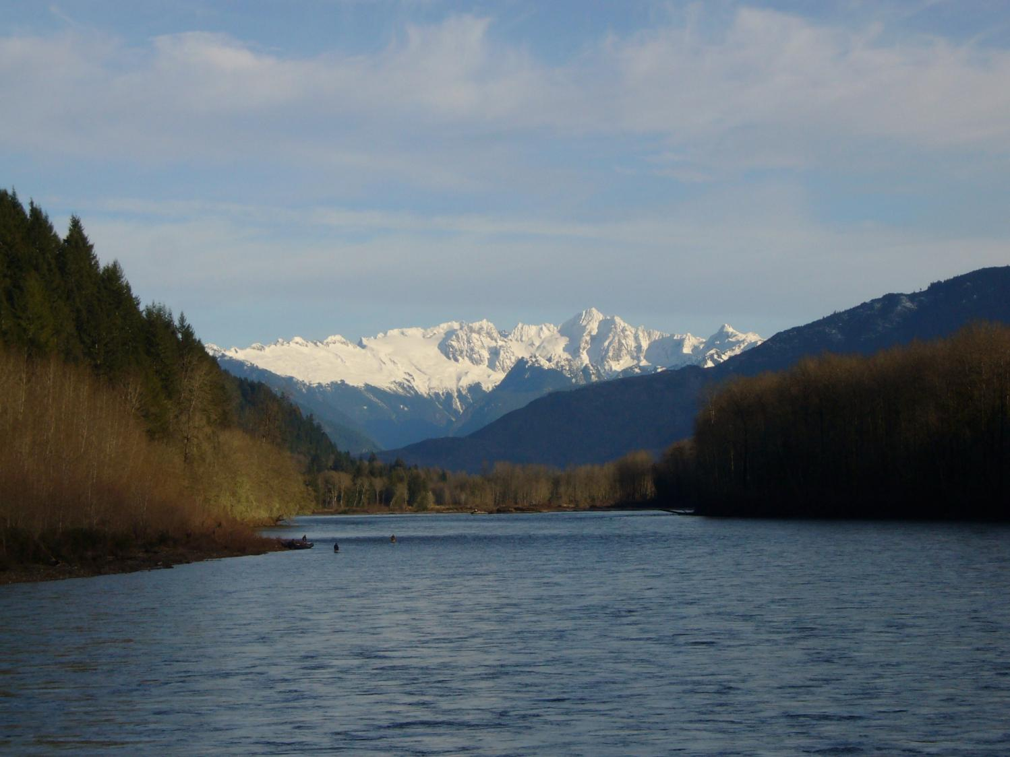
Successful Applicant Workshop
All slideshows in this series of trainings are optimized to be viewed in the slide show presentation format. Please click above or below on the slide show icon.
Upper Skagit River
Notes:
Welcome to the Successful Applicant Workshop presentation. Thank you for taking the time to learn about RCO’s Salmon Recovery grant program and the requirements and deliverables to manage a successful Salmon Recovery Funding Board project. This workshop provides training on basic grant administration for sponsors awarded Salmon Recovery grants.
This presentation has been provided online for your convenience.
If you have additional questions or if something is not covered in one of the chapters, please contact a grant manager directly.

Slide 2
Other RCO Grant Programs
Aquatic Lands Enhancement Account (ALEA)
Boating Facilities Program (BFP)
Boating Infrastructure Grant Program (BIG)
Estuary and Salmon Restoration Program (ESRP)
Family Forest Fish Passage Program (FFFPP)
Firearms and Archery Range Recreation Program (FARR)
Land and Water Conservation Fund (LWCF)
Non-highway and Off-Road Vehicle Activities Program (NOVA)
Recreational Trails Program (RTP)
Salmon Recovery Funding Board (SRFB)
Puget Sound Acquisition and Restoration (PSAR)
Washington Wildlife and Recreation Program (WWRP)
www.rco.wa.gov/grants/schedules.shtml
Notes:
This presentation covers information on SRFB grants, but you should be aware that RCO manages 10 other grant programs, many with overlapping interests. The highlighted grant programs have invested in salmon recovery projects. The Family Forest Fish Passage Program accepts applications year round. The WWRP and ALEA programs accept applications every two years, on even numbered years.

Slide 3
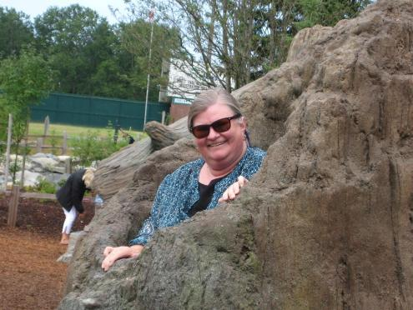
Kaleen Cottingham RCO Director
Notes:
Presentation to record for Salmon Successful Applicant Workshop
Good Afternoon! I’m Kaleen Cottingham, the Director of the Recreation and Conservation Office, which staffs the Salmon Recovery Funding Board and will be administering your grant.
Congratulations on being selected for a salmon recovery grant. I’m very excited that you are taking the time to go through these training presentations to learn skills that will help you successfully manage your project. We know that salmon recovery is challenging work. I want to thank all of you for the work you’ve done and are about to do, and for your dedication to helping Washington save this iconic species. Without you, salmon recovery simply would not happen.
Your projects are a very important part of Washington State’s salmon recovery effort. To date, the Salmon Recovery Funding Board has awarded over $500 million of state and federal money for more than 1,800 projects statewide.
RCO staff will walk you through your project implementation responsibilities that come along with receiving a SRFB grant throughout this training series. You will need to be careful stewards of these public funds.
I know that there is a lot of information contained within these presentations. But don’t fear --- RCO’s grant managers are here to help you with your project. If you don’t get all your questions answered today, contact your grant manager here at RCO. Or you can always refer back to these presentations in the future.
Good luck! We’re counting on this collective effort to deliver a future where Washington’s waters are once again teaming with wild salmon.
I would now like to turn the floor back over to our Salmon Recovery grant staff.

Slide 4
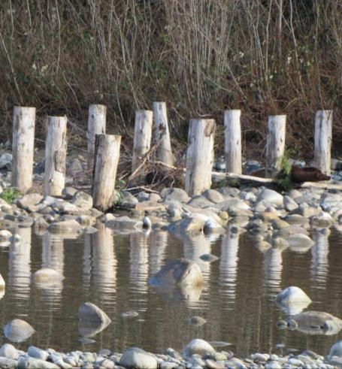
Successful Applicant Workshop Agenda
SRFB Project Agreement 101
Living Up to Expectations
Restoration Permitting Options
Meeting Project Deliverable Standards
Staying on Track
Requesting Amendments
Seeking Technical Assistance
Flood Fencing, Skykomish River
Notes:
This training has multiple chapters, each of which covers a different topic. There is an overview of your project agreement and our expectations in the Project Agreement 101 chapter. There is also a chapter that reviews options for Endangered Species Act consultation that can save you time and permitting expense called Restoration Permitting Options. In other chapters you can learn about RCO project management basics including, what to do if project scope or time frames shift, where to find technical assistance, and a quick tour of PRISM for project managers.

Slide 5
Other Available Trainings
Application Workshop
http://www.rco.wa.gov/doc_pages/other_pubs.shtml#salmon
Getting Paid – Reimbursement Information
http://www.rco.wa.gov/doc_pages/reimbursement.shtml
PRISM technical assistance
http://www.rco.wa.gov/prism_app/PRISM_Help.shtml
Notes:
There are other helpful trainings available online not included in this workshop.
First we have provided a recording of one of our Salmon Recovery Grant application workshops. You will find this helpful if you are trying to apply for funding for a new project.
Our, fiscal staff have provided an excellent series of online videos to help you navigate the billing process. Please refer to this training if you need help submitting bills for payment.
Lastly, if you need some assistance using PRISM online or the PRISM 2007 Workbench, there are some tutorial videos available on the RCO website that may answer your questions.

Slide 6
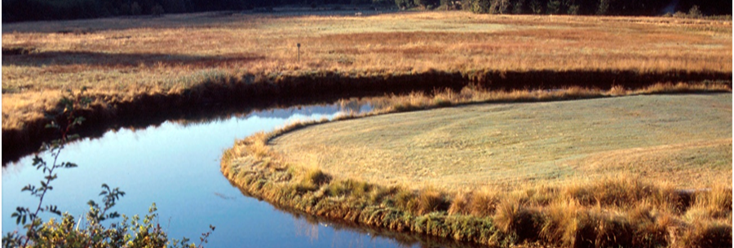
Expected Workshop Outcomes
Be familiar with RCO’s project agreement
Know where to find key information.
Understand your project implementation responsibilities.
Understand how Grant Managers can assist you.
Be able to successfully implement your SRFB funded project.
Salt Creek Estuary
Notes:
We hope that by the time you’re done listening to the Successful Applicant presentations you’ll become acquainted with your project agreement, know where to find important information, understand your responsibilities, and how RCO can help you successfully implement your salmon recovery project.
And, as mentioned before, you can always contact your salmon grant manager if you have any questions.

