Slide 1
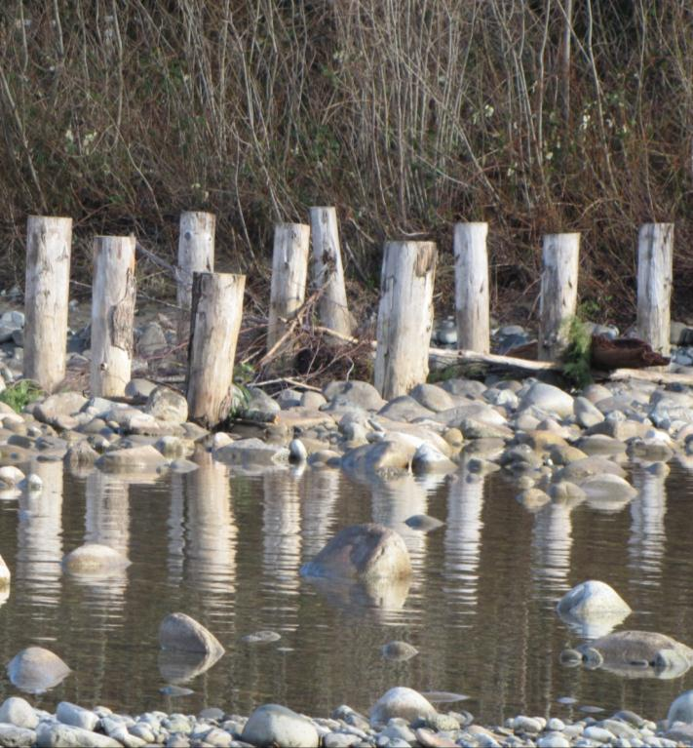
Successful Applicant Workshop Agenda
SRFB Project Agreement 101
Living Up to Expectations
Restoration Permitting Options
Meeting Project Deliverable Standards
Staying on Track
Requesting Amendments
Seeking Technical Assistance
Flood Fencing, Skykomish River
All slideshows in this series of trainings are optimized to be viewed in the slide show presentation format. Please click above or below on the slide show icon.
Notes:
This presentation covers information on seeking technical assistance.

Slide 2
Technical Assistance Available
Updated
Spring 2012
www.wdfw.wa.gov/conservation/habitat/planning/ahg/index.html
Notes:
The first document is the Stream Habitat Restoration Guidance. The original publication for this was in 2004 and was updated in 2012 to incorporate general updates to reflect best available science and emerging technology over the past 7 years. This is a very robust document that provides technical information on a wide range of best management practices for stream restoration. Anyone working on salmon restoration project will find helpful information to help guide and design the project.
NEW TOPICS in the revised version od the document include
Dedicating Land and Water to Stream Ecosystem Recovery
Climate Change Appendix
Public Safety Appendix
Improved discussion of project planning & design

Slide 3
Technical Assistance Available
Water Crossing Design Guidelines
Updated 2013
http://wdfw.wa.gov/publications/01501/wdfw01501.pdf
Notes:
Another document you’re likely familiar with is the Design if Road Culverts for Fish Passage. It was originally published in 2003 and is currently being updated to include bridge guidance. It was due out this spring but has met with some delays and at this point we don’t know when to expect its release.

Slide 4
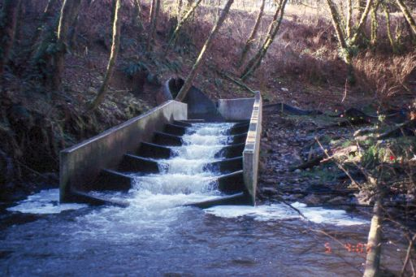
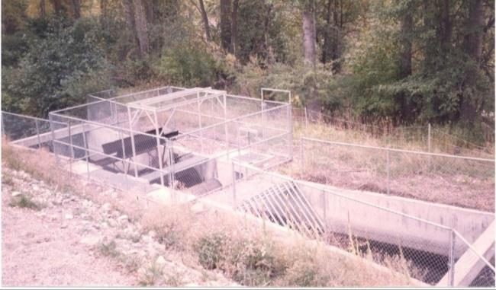
Technical Assistance Available
Fishway Guidelines
2000 Drafts:
Fish Protection Screen Guidelines
Update in process
www.wdfw.wa.gov/conservation/habitat/planning/ahg/index.html
Notes:
Two other lesser known guidelines are the Fishway Guidelines and the Fish Protection Screen Guidelines that were published as drafts in 2000. The Fish Protection Screen Guidelines are also currently being updated.

Slide 5
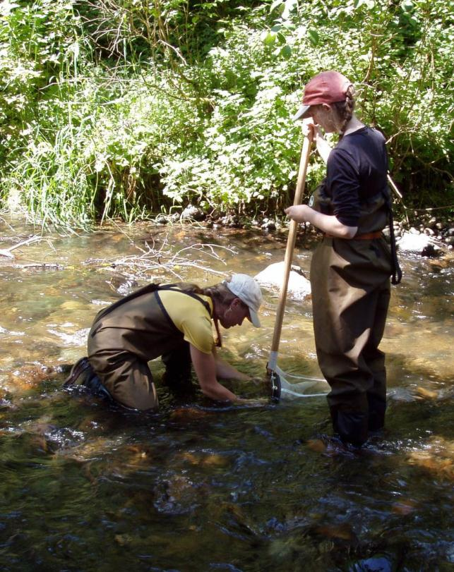
Technical Assistance Available
Biological
WDFW Area Habitat Biologists
WDFW Area Fish Biologists
WDFW Area Wildlife Biologists
Kick Net Sampling Issaquah Creek, (King County Log Cabin property)
Notes:
If you’re looking for biological technical assistance, WDFW is a tremendous resource. Each lead entity has been assigned a watershed steward. They should be your primary contact. They can provide a lot of information and guidance on the fish and habitat concerns in your area. If you’re not already familiar with your watershed steward, refer to Manual 18, App A for their contact information.
Other WDFW biologists that are excellent resources for information include:
Area Habitat Biologists-- issue the HPAs and are very familiar with the area.
Area Fish Biologists--- monitor fish populations across the state
Area Wildlife Biologists--- monitor wildlife populations;
Can be extremely helpful with advice on how to optimize project benefits to wildlife as well as for fish, which can be extremely important, especially for riparian, off channel, and estuary projects.
Keep in mind that the habitat biologists, fish biologists, and wildlife biologists should be contacted via your watershed steward.

Slide 6
Technical Assistance Available
Fish Screening (WDFW Web site)
www.wdfw.wa.gov/conservation/habitat/planning/screening/
Fish Passage (WDFW Web site)
www.wdfw.wa.gov/conservation/habitat/fish_passage/
Fish Passage Barrier and Surface Water Diversion Screening Assessment and Prioritization Manual
www.wdfw.wa.gov/publications/pub.php?id=00061
Notes:
The WDFW website is also a good resource. It offers a lot of information pertaining to fish passage and screening projects and barrier inventories. Barrier inventory projects are expected to follow the Fish Passage Barrier and Surface Water Diversion Screening Assessment and Prioritization Manual
This can be downloaded off the web at the address shown on your screen.

